Slide 1
CAPSTONE PROJECT
Electricity Theft Detection
in Distribution Networks using Machine Learning
AI/ML-based smart-meter analytics to flag high-risk consumers and
prioritise field inspection for power distribution utilities.
Presented by: Kanakkaparambil Nivedsagar [UTK23EE1001]

Slide 2
The Problem: Non-Technical Losses (NTL)
Electricity theft and meter tampering silently drain utility revenue and destabilise distribution networks — and current detection methods can't keep up.
15–30%
$96B+
Random
of distributed energy lost to NTL in some regions
estimated annual global cost of electricity theft
field inspections today — mostly find nothing
Why current methods fail:
Manual inspections are slow, costly, and poorly targeted
Smart-meter (AMI) data is now collected at scale — but too voluminous to review manually
Consumers who tamper meters rarely self-report
2

Slide 3
Objective
1
Engineer Behavioural Features
2
Build & Compare ML Models
Extract statistical/behavioural signatures from daily AMI consumption data that reveal tampering patterns.
Train Logistic Regression, Random Forest, Gradient Boosting and SVM classifiers to flag theft-risk consumers.
3
Evaluate Rigorously
4
Deploy a Working Prototype
Use Accuracy, Precision, Recall, F1 and ROC-AUC — metrics suited to a highly imbalanced classification problem.
Ship a Streamlit web app for single-consumer checks and batch CSV screening, ready for analyst use.
3

Slide 4
Project Workflow
Problem
Definition
Data
Collection
Preprocessing
EDA
Feature
Engineering
Model
Training
Evaluation
Deployment
/ Demo
A classical, feature-engineering-driven ML pipeline — interpretable, fast to train, and practical for utility-scale deployment.
4

Slide 5
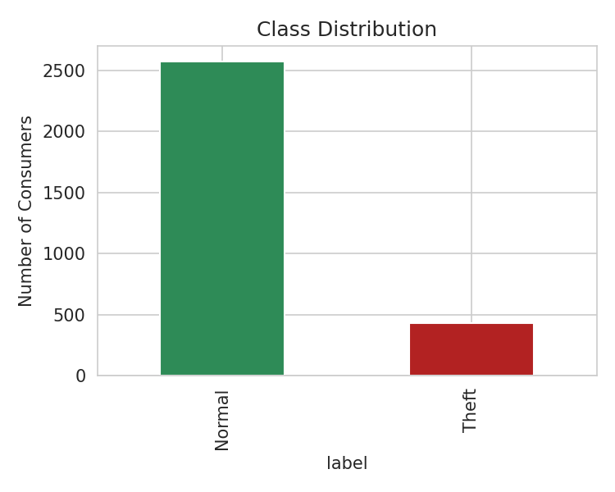
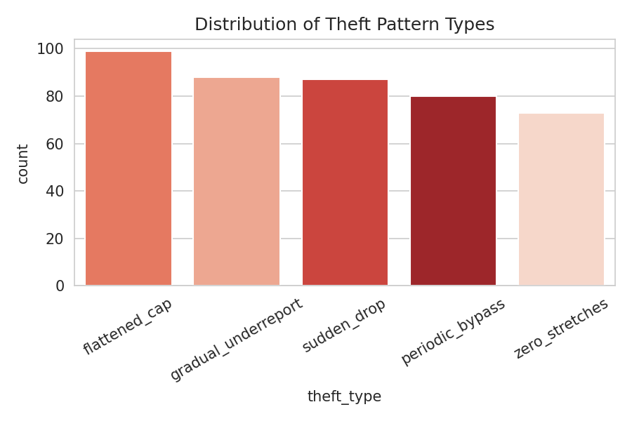
Dataset: Simulated Smart-Meter (AMI) Data
3,000 consumers · 180 days of daily kWh readings each · modelled on real AMI dataset structure (e.g., SGCC)
5 Simulated Theft
Signatures
Sudden Drop
Zero Stretches (bypass)
Flattened / Capped Reading
Gradual Under-reporting
Periodic Weekend Bypass
~14% of consumers (427) exhibit a theft pattern — realistic class imbalance
5

Slide 6
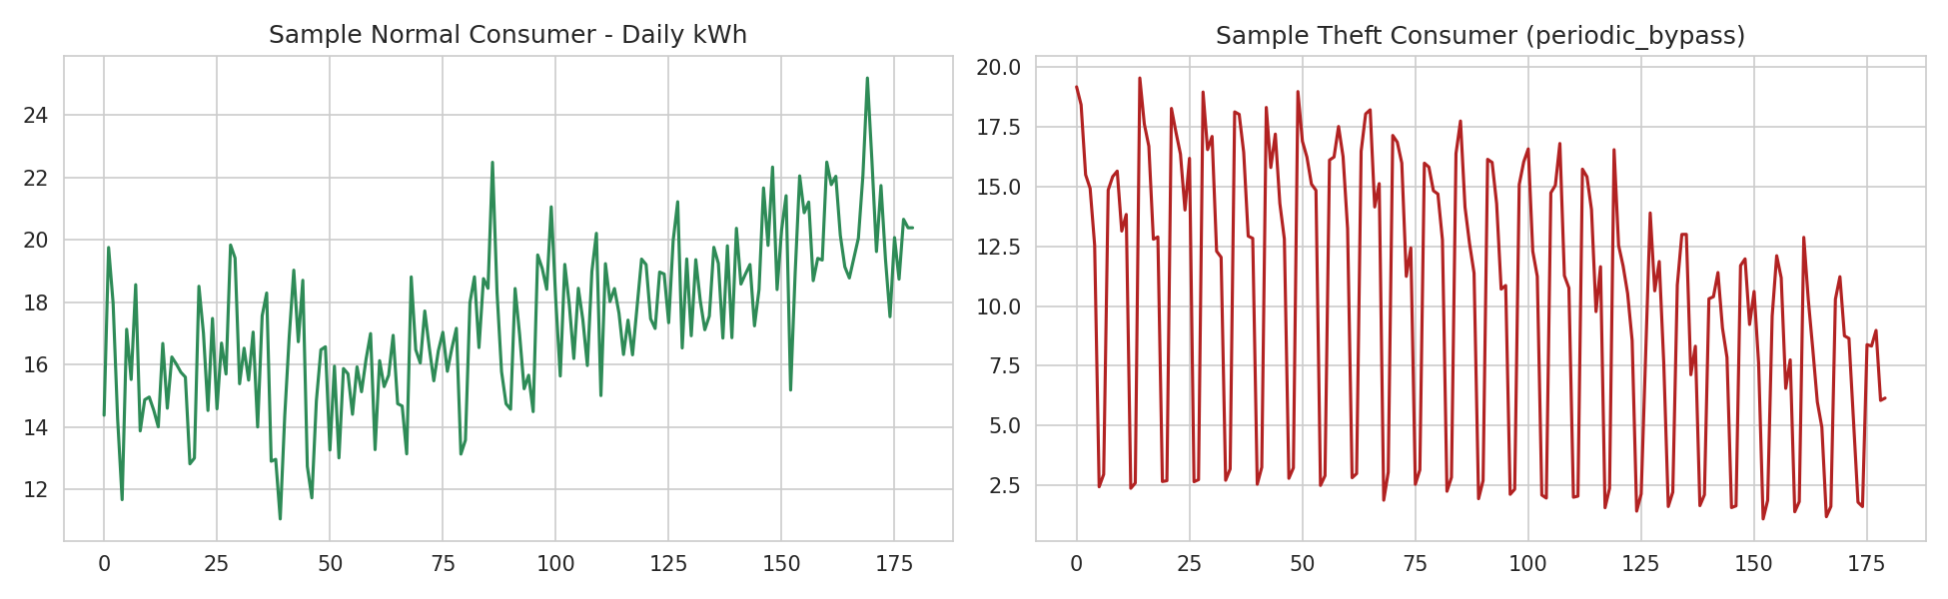
Exploratory Data Analysis
Key observation: Theft consumers show irregular drops, flattening, or long zero-stretches that a normal load profile never exhibits — this behavioural gap is exactly what our engineered features capture.
6

Slide 7
Feature Engineering
13 statistical & behavioural features engineered per consumer from raw 180-day series:
mean / median / min / max daily kWh
std_daily_kwh, coefficient_of_variation
Overall consumption level
Volatility of daily usage
zero_day_fraction
trend_ratio
Bypass / zero-stretch tampering
Gradual under-reporting
weekday_weekend_ratio
sudden_drop_count
Periodic weekend-only bypass
Abrupt tampering events
weekly_cv
near_cap_fraction
Week-to-week inconsistency
Flattened / capped readings
7

Slide 8
Model Training & Comparison
Four classifiers trained on an 80/20 stratified split, with class-balancing to handle the ~86:14 imbalance:
Winner: Gradient Boosting
97.17%
Accuracy
0.894
F1-Score (Theft)
0.991
ROC-AUC
8

Slide 9
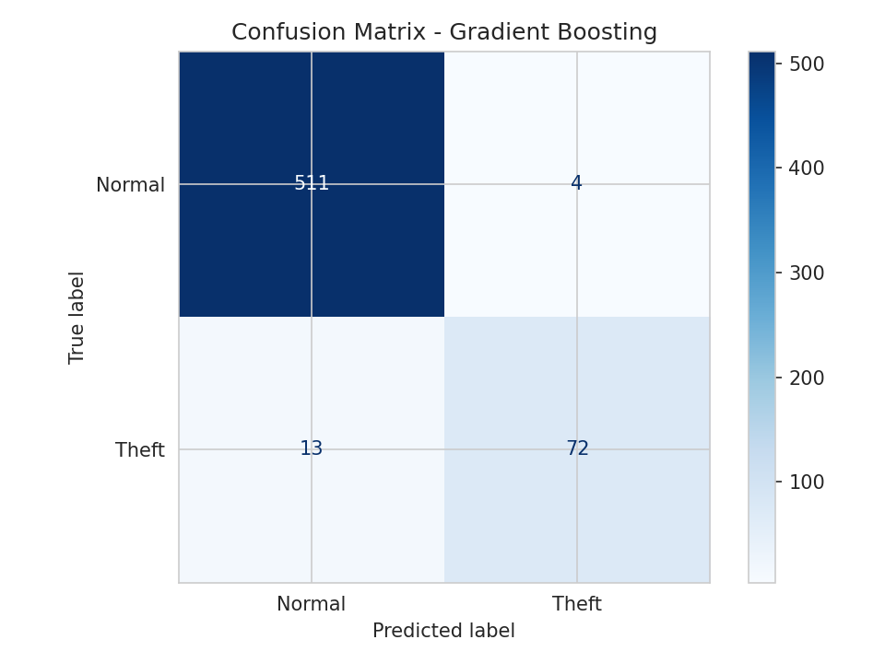
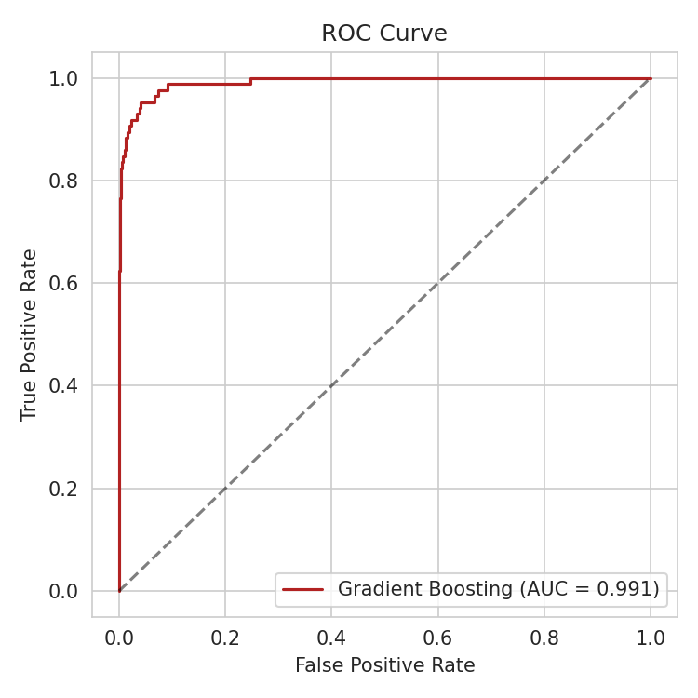
Model Evaluation
On 600 held-out consumers:
72 of 85 theft cases correctly caught (~85% recall)
Only 4 false alarms out of 515 normal consumers (<1% FPR)
High precision keeps inspection costs low
Feature importance confirms zero_day_fraction, trend_ratio and sudden_drop_count as the strongest predictors — directly matching known theft signatures.
9

Slide 10
Deployment: Streamlit Web Application
1
2
3
Single Consumer Check
Batch Upload (CSV)
Model Performance
Simulate a theft pattern or paste real daily readings — get an instant risk prediction with probability and visual load curve.
Upload a multi-consumer CSV in AMI format and receive a ranked theft-risk worklist, exportable for field teams.
Transparent view of the comparison table, confusion matrix, ROC curve and feature importances for stakeholder review.
10

Slide 11
Conclusion & Future Scope
Conclusion
Future Scope
Interpretable behavioural features outperform raw time-series for this tabular, moderate-sized dataset
Gradient Boosting achieves 97.2% accuracy, 0.89 F1 and 0.99 ROC-AUC
Prototype is lightweight, explainable, and ready for a real utility pilot
Validate on real utility AMI + inspection-audit data
Add transformer-level & neighbourhood-comparison features
Explore LSTM / Temporal CNN once more labelled data is available
Integrate into a live SCADA / AMI utility dashboard
11

Slide 12
Thank You

